Slide 1

Learning Intentions: Today we are continuing our learning about human nature, focusing on free will.
Success Criteria: By the end of the lesson I will:
. Understand the concept of free will including where this idea comes from.

Slide 2
Judaism
Beliefs
• beliefs about God
• nature of human beings: yetzer tov; yetzer harah; free will; suffering
• beliefs about Covenant
• judgement; the Messiah; the Messianic Age; Olam Ha’ba
Practices
• living according to the Commandments
• Rosh Hashanah; Yom Kippur
• worship: Shabbat; synagogue

Slide 3
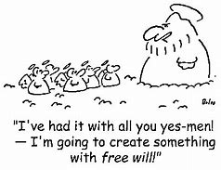
Starter task: Discuss
Why do you think God would give humans free will?
Do you think this was a good idea?

Slide 4
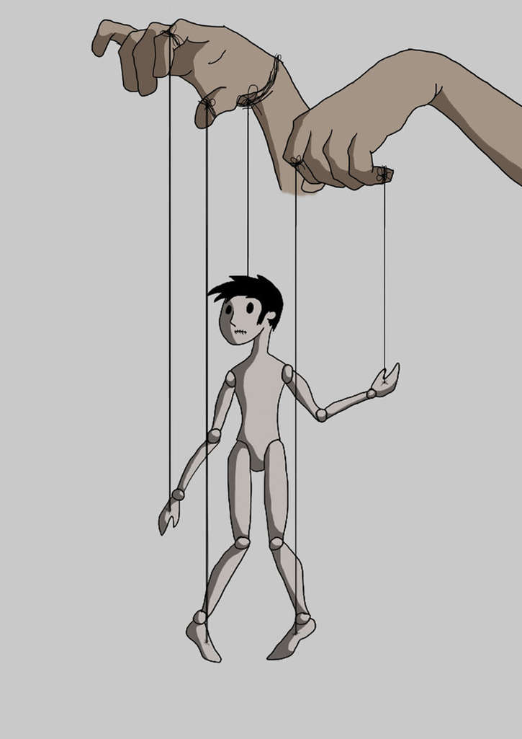
25.8.22 Free will
The idea of free will is simply the belief that humans have the ability to act freely in their choices and actions.
It is seen as the greatest gift from God.
God doesn’t want puppets.
He wants people to choose to love him.
That is true love.

Slide 5
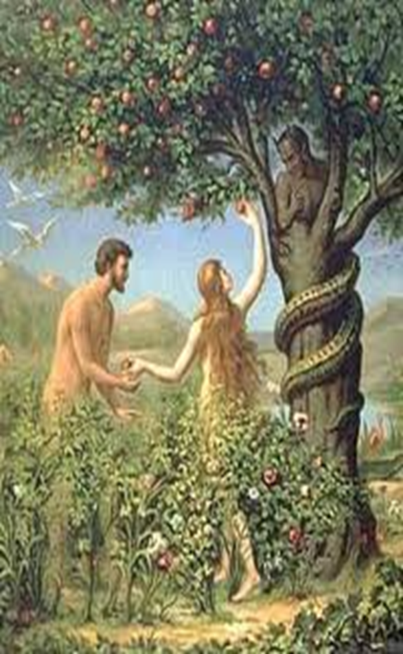
To truly understand it we need to read the story of Adam and Eve in the Torah.
It is traditionally called ‘the fall of man.’

Slide 6
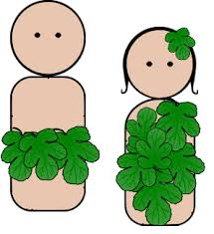
Task:
Read together: Genesis 3 v1-24

Slide 7

Task:
Create a mind map (or notes) explaining the fall of man
It needs to include:
. Life for Adam and Eve before the fall
. What caused the fall
. What was the result
. How God reacted
. How Adam and Eve reacted
. The reference in the Torah
. This verse which you need to learn.
Think about what this teaches us about the nature of God and the nature of humanity.
‘And the LORD God commanded the man, “You are free to eat from any tree in the garden.” Genesis
Genesis 3 v1-24

Slide 8
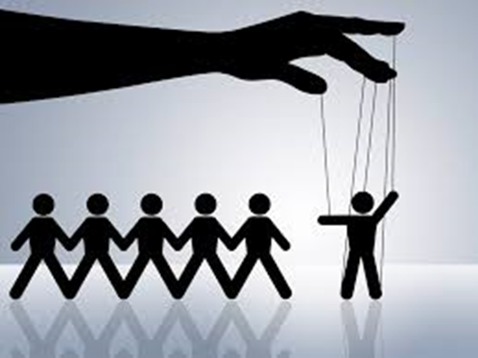

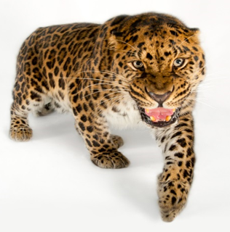
The fall of mankind is the first clear sign that humans have free will; that there is within all humanity the capacity to freely choose how to behave.
We are not puppets!
This approach is centred on the belief that humans are radically different from animals. An animal can only ever act on instinct, whereas humans are free to choose how to live.
Can you think of 3 examples of animal instinct?

Slide 9


Slide 10
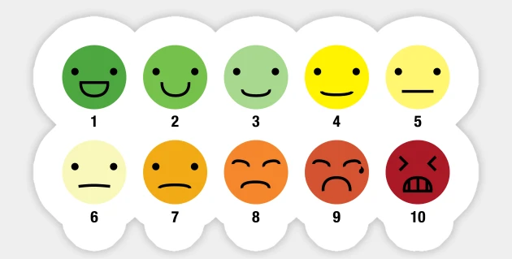
Starter task:
Rate your weekend.
Tell the person next to you which face your are and why.

Slide 11

Judaism
Beliefs
• beliefs about God
• nature of human beings: yetzer tov; yetzer harah; free will; suffering
• beliefs about Covenant
• judgement; the Messiah; the Messianic Age; Olam Ha’ba
Practices
• living according to the Commandments
• Rosh Hashanah; Yom Kippur
• worship: Shabbat; synagogue

Slide 12

God allowed Adam and Eve to act on their freewill without interfering, showing that humans have the ability to disobey God.
How does this link into the idea of the yetzer Tov/Harah?

Slide 13
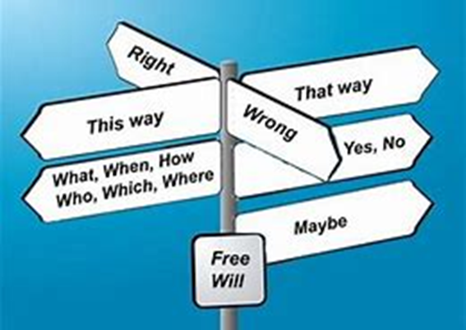
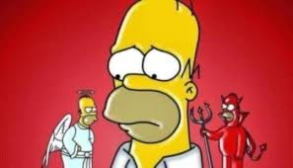
The YH & YT are the ways in which Jewish people use their free will. Either to act in a moral way or to act in a way that could be regarded as selfish.
They can listen to their moral conscience (YT) and choose to act in a way that will reunite them with God, or they can ignore their moral conscience and move further and further away.

Slide 14
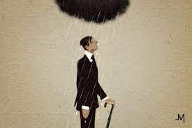
When human beings choose to follow their YH impulse, they are choosing to go against God’s wishes and as a result, suffering will happen.
Remember what happened to Adam and Eve as a result of their choice?
Can you think of other examples where peoples free will has led to them making selfish choices that create suffering for others?

Slide 15


Jews must learn what God has taught about what is right and what is wrong; and they are then left to choose between them.
This includes the ability to obey or disobey God, the ability to choose between good or evil.

Slide 16
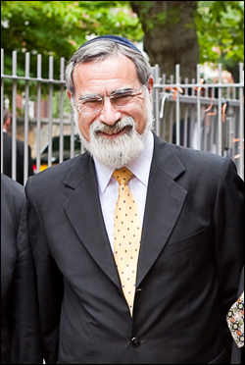
“Nature is not the final word, for nature itself was created by a being who stands outside it and who, but making us in his image, gave us the power to stand outside it.
We are free. We can choose.
We are not predestined by chance, fate, the stars, our darker instincts or the human genome. We can opt for freedom over determinism, justice over the power of power; we can stop at the brink of history’s endless replays and chart a different course.
We cannot defeat death, but we can defeat all those forces that lead human beings to kill other, innocent human beings. We can choose life. ”
Rabbi Sacks
Choose a quote from this and add it to your notes

